Slide 1
Application frameworks
Spring Boot

Slide 2

Overview
Spring Framework
Spring Boot

Slide 3
Spring Framework
A complete Java platform aimed at enterprise application development.
Pre-configured configurations so that the developers can focus on the business logic.
Simpler application configuration and development comparing to other enterprise application frameworks like EJB.
Most famous for its inversion of controller container for dependency injection.
Other features include MVC web application, REST web service, Cloud integrations, and a JPA like implementation for Data access.

Slide 4
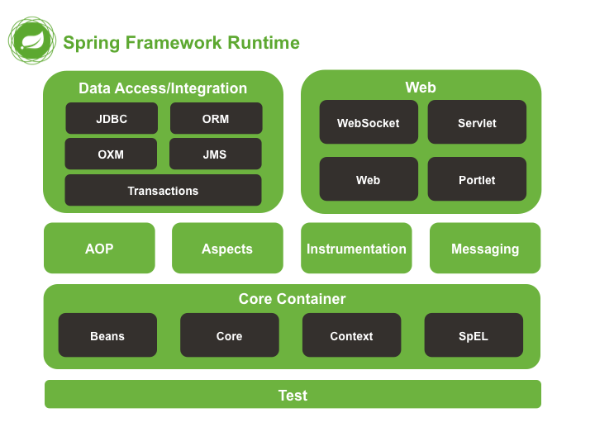

Slide 5
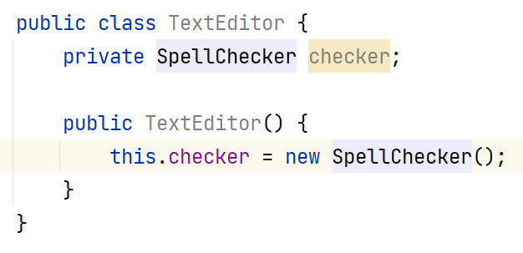
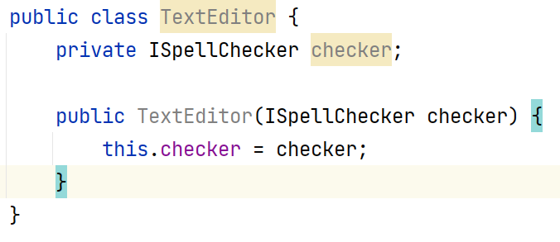
Dependency Injection
A type of Inversion of control.
Passing the dependency at runtime (mostly) into the class without concreate dependencies.
Resulting context is low coupling between classes.

Slide 6
Spring DI
Maven dependency
<dependency> <groupId>org.springframework</groupId> <artifactId>spring-context</artifactId> <version>4.0.0.RELEASE</version> </dependency>
Injections
Setter based - @Autowired on top of the setter
Constructor based - @Autowired on top of the constructor
Field based - @Autowired on top of the field (highly discouraged)

Slide 7
Some common annotations
@Component
Making class Spring container aware as a Component.
@Service
Making class Spring container aware as a Service.
@Repository
Making class Spring container aware as a DAO.
@RestController
Making class Spring container aware as a REST controller.
@Configurations
Spring aware configuration class.
@Autowired

Slide 8

Nice framework but the amount of configuration it has, made it cumbersome to use for rapid application development

Slide 9
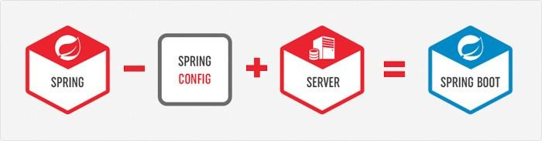
Spring Boot
Fully featured robust framework mainly targeted for Microservices application development.
A solution for cumbersome configuration Spring Framework has.
Support for microservices.
Easy integration with multiple other libraries and frameworks (Cloud, Circuit breakers)
Embedded server for development and deployments.

Slide 10
Spring Boot Starters
Complete packages with different capabilities.
Ability include capabilities just by adding a single dependency.
AWS Cloud integrations, Database integrations.
Use maven parent module configuration.

Slide 11
Application configurations
Any external configuration to the application.
DB connection string
External endpoints
Timeouts, thread pool sizes.
Can be saved in resources directory
Files (.properties, .yaml)
External server (Spring configuration server, Consul)
Property files are most common
Stored in Key Value pairs.
Type of a Hashtable called Properties.
No hierarchical data support.
Yaml
Relatively new.
Hierarchical data support.
No inbuilt support in Java. Fully supported in Spring.

Slide 12
Guidelines
Always stick to REST constraints.
Use Java Packages wisely.
Code reusability, readability.
Always think the business logic in OOP model. REST and DAL layer can be exceptions.
DTOs are only for transferring the data not to keep the state where the behavior in another class.
Use interfaces only when it is required.
Use Autowiring wisely, always keep in mind that default autowiring is singleton.

Slide 13


